Slide 1
Our partition wall system TK-​flexi
TK-flexi.de

Slide 2
TK-​flexi The partition walls convey a feeling of security to staff and customers.
TK-flexi.de

Slide 3
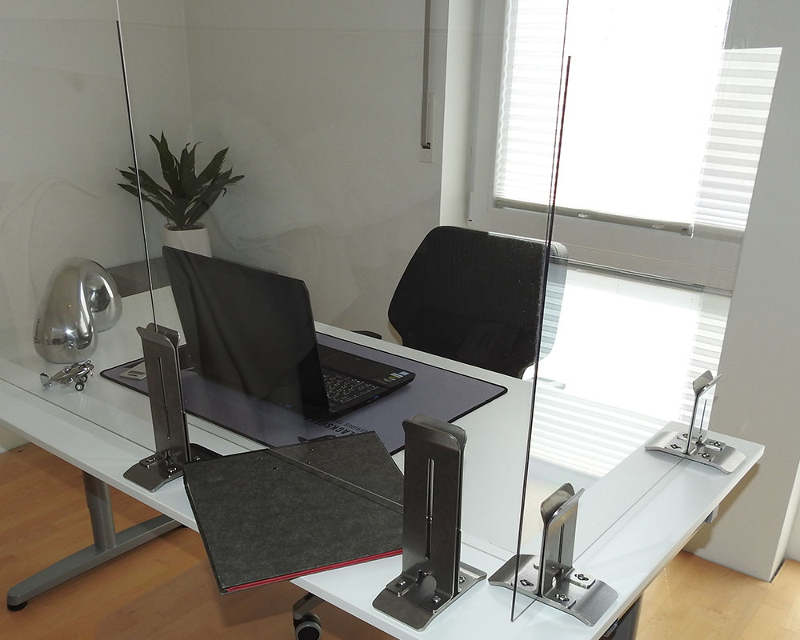
TK-flexi As separators on customer counters, desks, etc.
TK-flexi.de

Slide 4
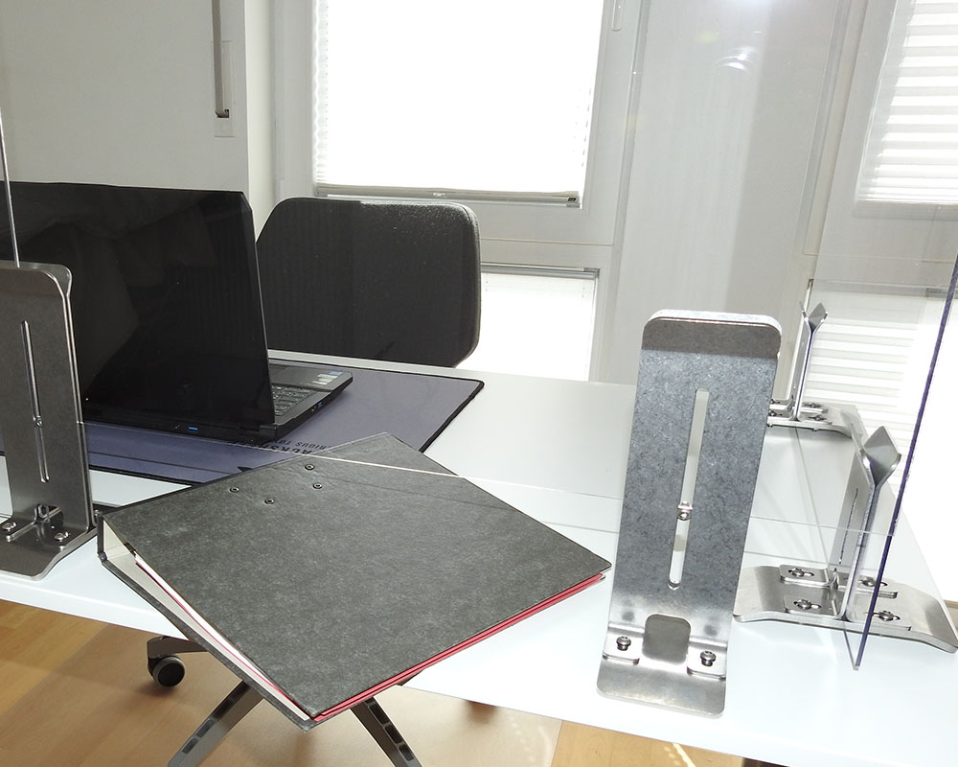
TK-flexi Service hatch for the counter area (height & width adjustable)
TK-flexi.de

Slide 5
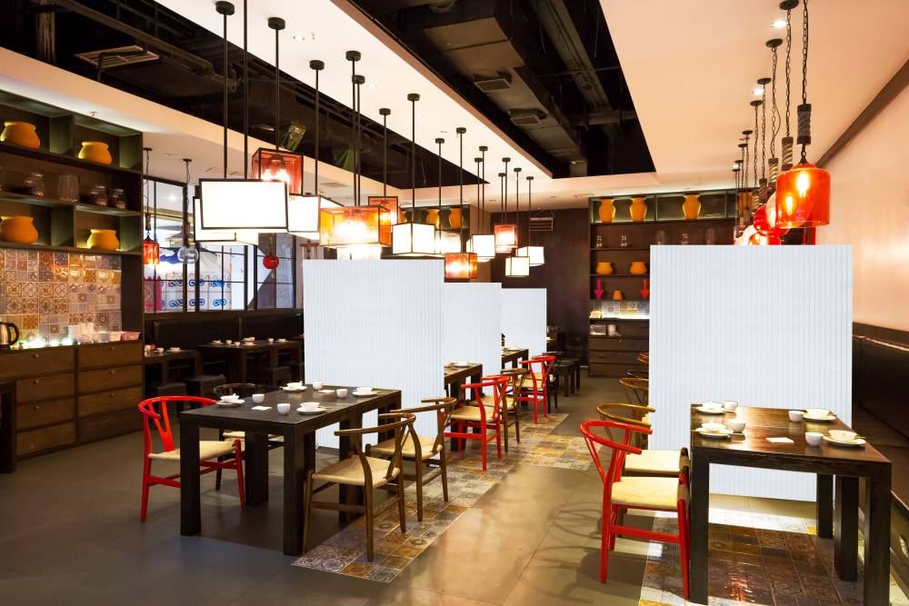
TK-flexi Suitable as room dividers (up to 190 cm build height)
TK-flexi.de

Slide 6
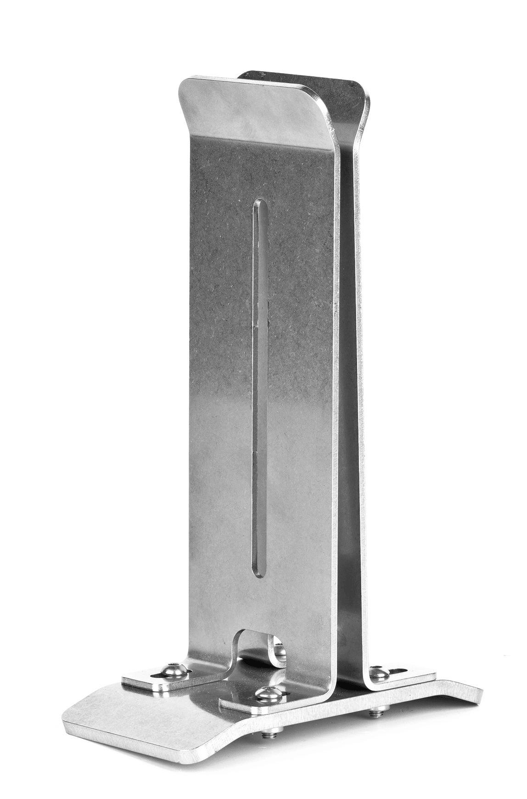
Two different materials
V2A Stainless Steel
TK-flexi.de

Slide 7
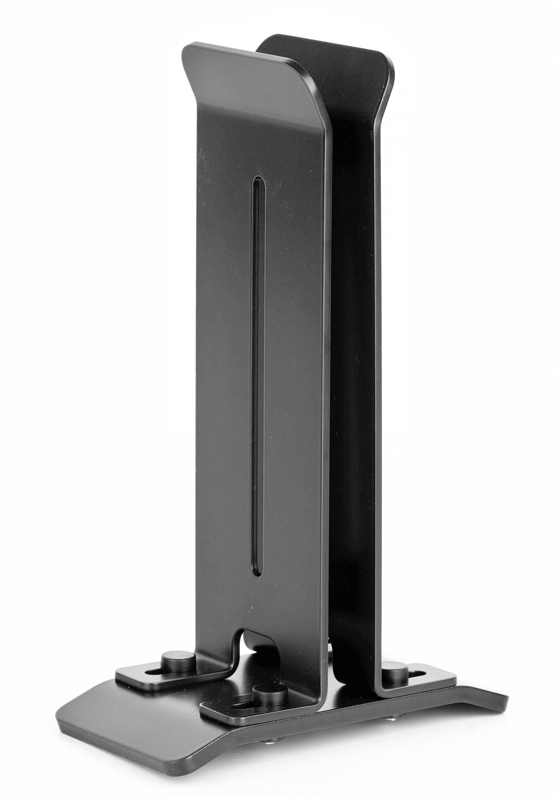
Two different materials
Steel
Powder coated
TK-flexi.de

Slide 8
Adjustable in width to suit various wall thicknesses
0-18 mm
TK-flexi.de

Slide 9
Wall is adjustable in hight
ca. 15-150 mm
TK-flexi.de

Slide 10
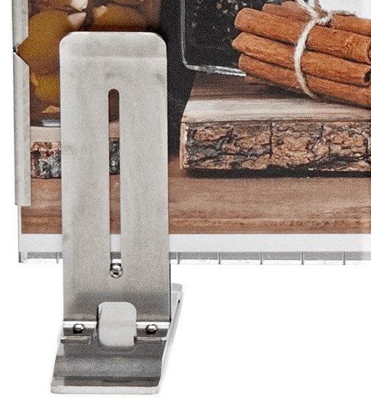
Wall is adjustable in hight
ca. 15-150 mm
Adjustment screw
TK-flexi.de

Slide 11
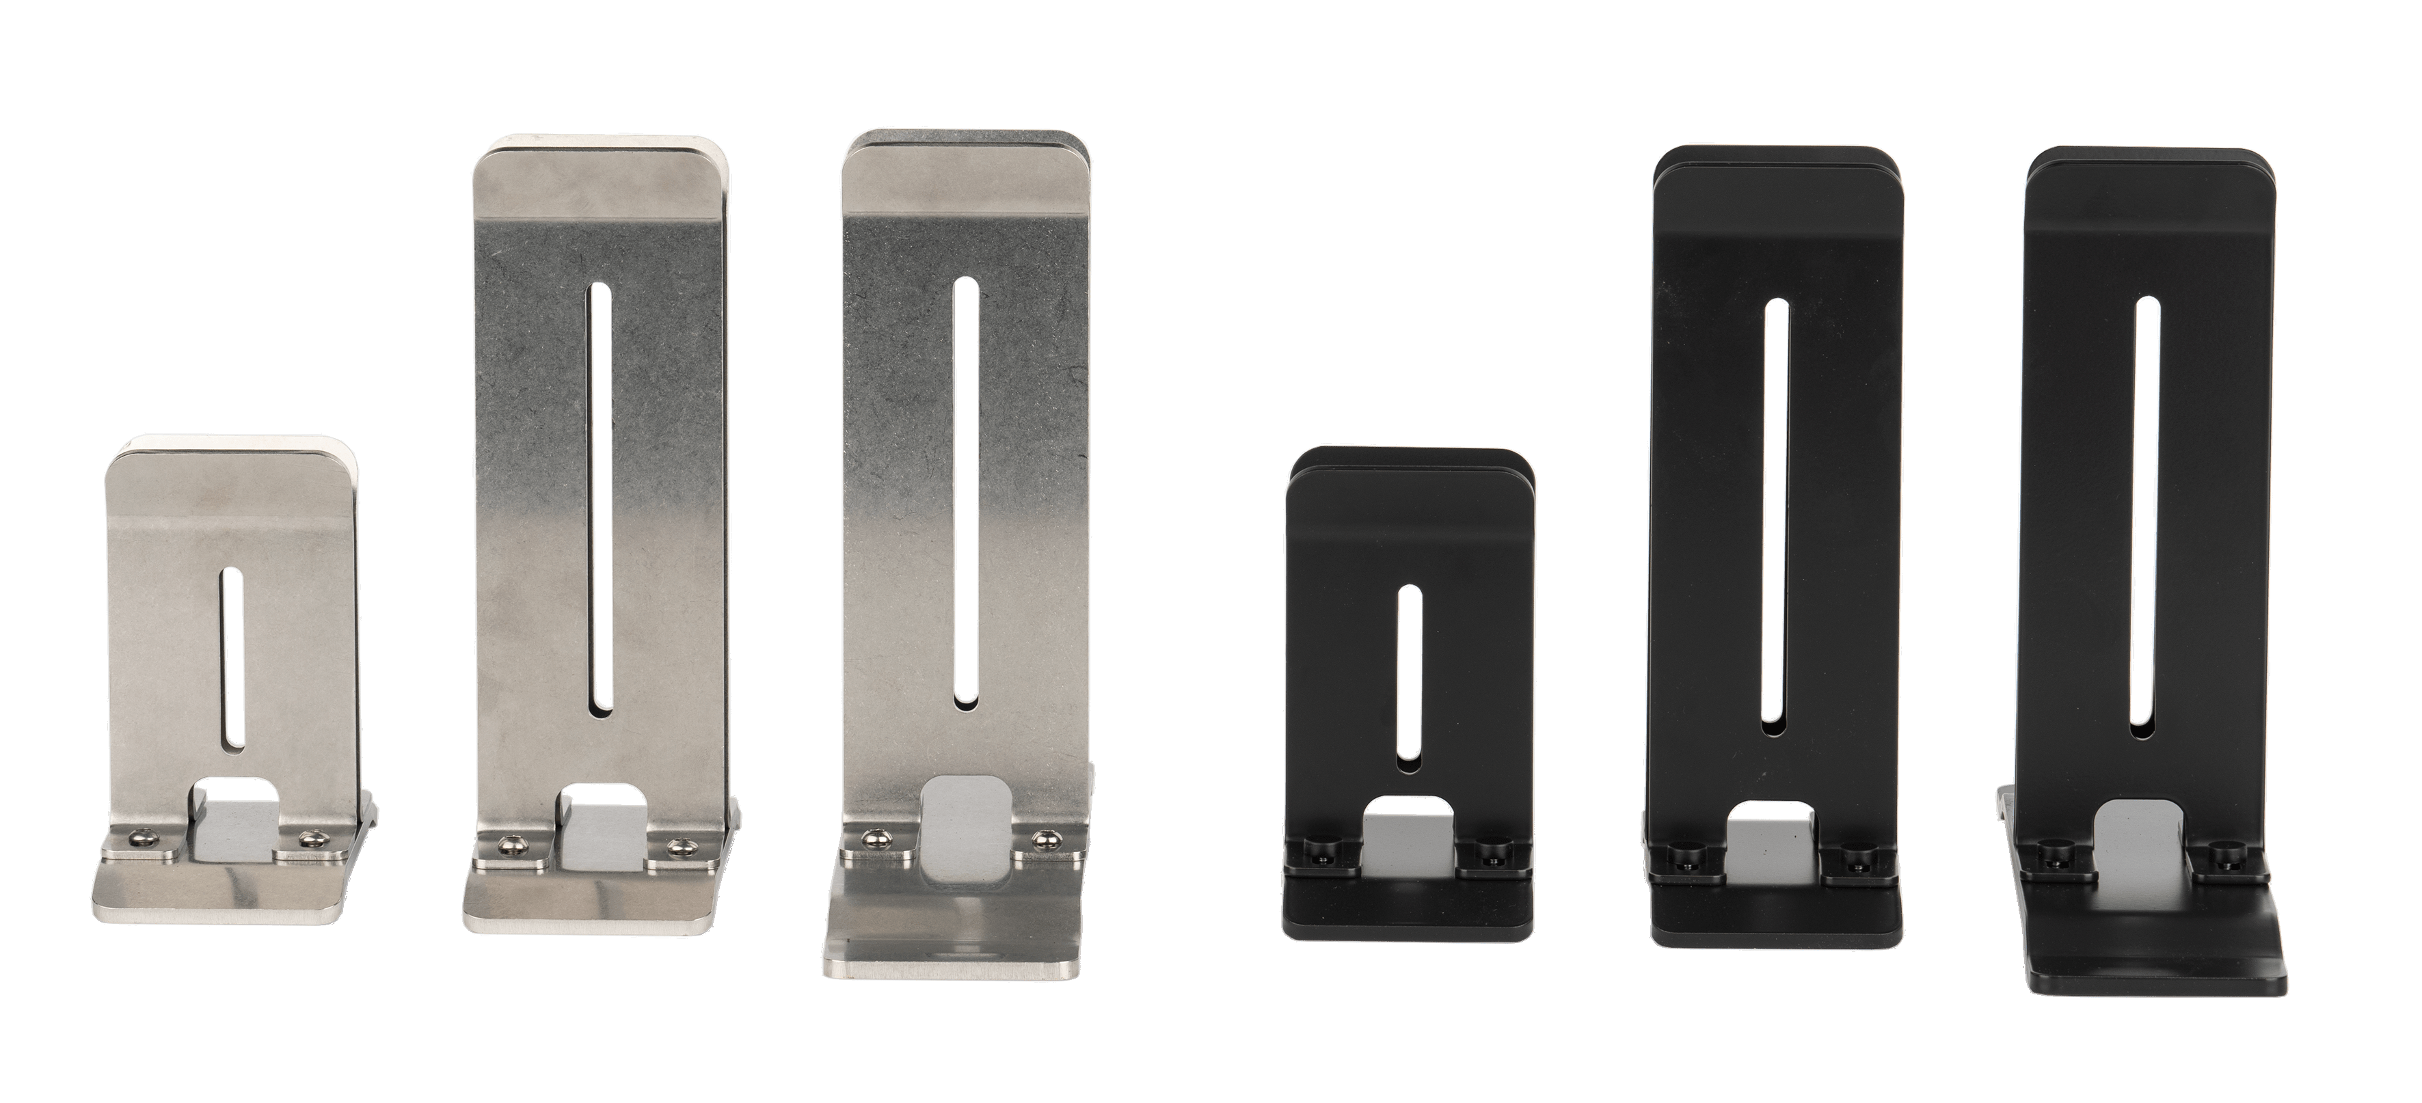
Different variants available
TK-flexi.de

Slide 12
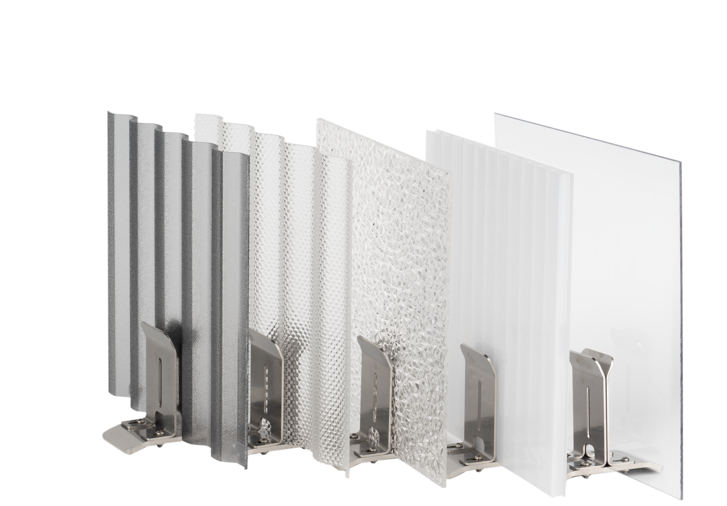
Suitable for different variants of walls
0-18 mm
TK-flexi.de

Slide 13
Impressions
TK-flexi.de

Slide 14
Impressions
TK-flexi.de

Slide 15
Impressions
TK-flexi.de

Slide 16
Impressions
TK-flexi.de

